Slide 1

Building Resilience 2
Managing my low mood
This programme aims to provide an understanding of how our feelings, thoughts and behaviour interact to produce common difficulties, and to enable participants to learn strategies to manage these difficulties, so that they can tackle these challenges with greater confidence in their abilities to cope and thrive.
Notes:
This is one of three psychoeducational workshops offered by the Counselling Service in our rolling programme ‘Building Resilience’. You may be here because a counsellor, GP or mental health advisor has recommended it as the first step in getting some psychological help, or you may have decided yourself to come. You might be here to help yourself, or to find out more about low mood to help others. Whichever it is, we hope you find it valuable. You won’t be expected to speak or contribute in any way unless you want to. You each have a handout of all the information on the slides that you are welcome to make notes on

Slide 2
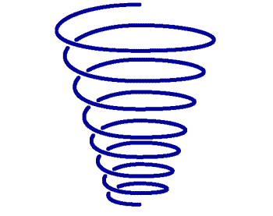
Building Resilience 2
iCan manage my low mood
Notes:
Each of our BR workshops has a ‘motif’ that we will use to help you to remember the take home messages. With ‘iCan manage my low mood’ we are using a spiral

Slide 3
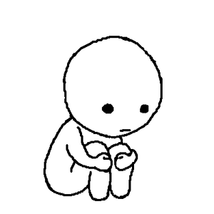

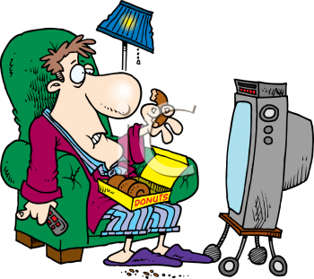
What is Low Mood?
Notes:
What is low mood? There is a difference between feeling ‘a bit fed up’ , more persistent low mood, and clinical depression. How would you describe what it means to you? Write these down

Slide 4

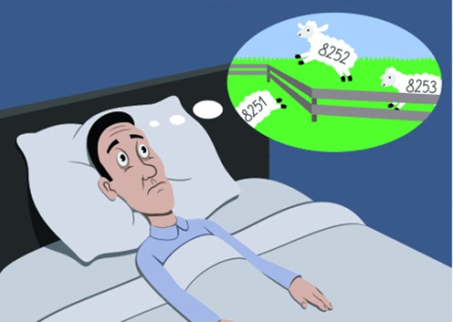
Signs and symptoms
Loss of focus/ concentration/ motivation.
Difficulty in getting up in the morning.
Sleep problems.
Seeing no point in anything.
Feelings of worthlessness.
Tearfulness.
Loss of appetite - or comfort eating.
Withdrawing from usual activities, hobbies, friendships.
Notes:
Here are some of the signs and symptoms. You may be experiencing some or all of these- and there may be others

Slide 5
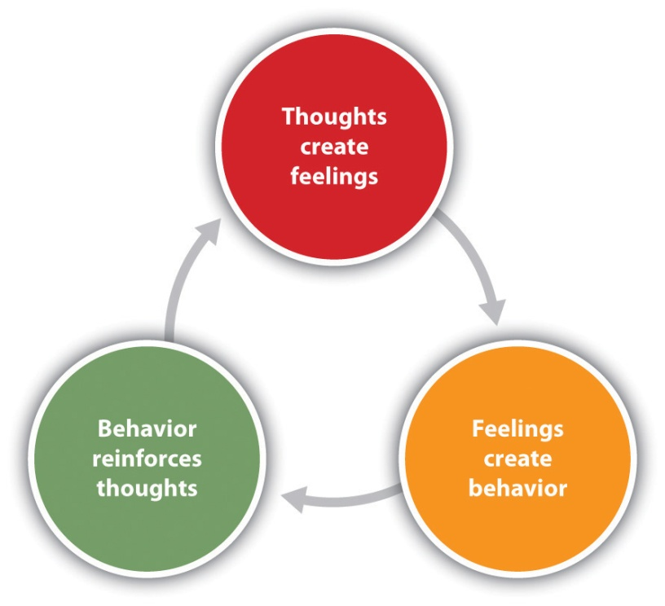
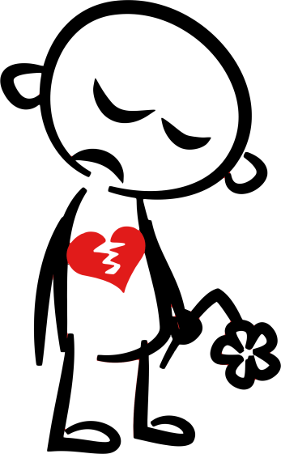
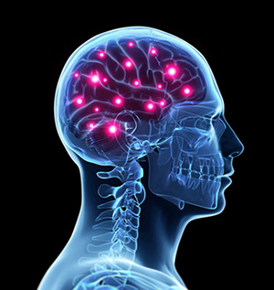
What can cause low mood?
No one cause-
A reaction to loss (not just bereavement)?
Anger turned inwards?
Cycle of negative thinking?
A chemical change in the brain?
Notes:
There are lots of ideas about what can cause low mood. Your own personal thoughts about this may help you understand how your low mood may have started. Which of the possibilities on the slide seem most relevant to you?
In many cases of depression, there is a reduction in the amount of certain neurotransmitters found (monoamines such as serotonin and norepinephrine) in depressed people.
Low serotonin levels are simply another symptom of depression, not a cause?
"Regarding depression as "just" a chemical imbalance wildly misconstrues the disorder." - Psychology Today, March 1999
‘Drug therapies that work on this imbalance lift depression completely in a third of those who take them and partially in another third. For a third of people, antidepressants don't work at all, and many who do get positive results stop taking them because the side effects are worse than the depression symptoms they are supposed to be treating.’ (Clinical depression.co.uk)

Slide 6
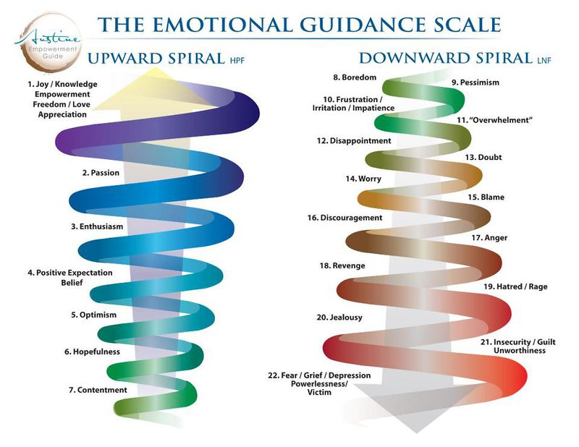
The Downward Spiral of low mood
(Ester & Graham Hicks 2010)
Notes:
What we do know is that low mood can spiral downwards and that something going wrong in one area of your life can then start a spiralling down that feels difficult to stop. In the slide here you can see the sorts of feelings that can send us spiralling down. Although as we spiral down the spiral gets tighter and more restrictive …

Slide 7
5 key areas:
People and events around us
Critical/unhelpful thoughts
Altered feelings
Physical feelings
Behaviour and activity levels
Notes:
There are 5 key areas that affect each other and can maintain this negative ‘spiral’.
So for example an event- maybe something outside our control, could challenge us- or something interpersonal may go wrong. So we might fall out with a friend or partner, we might lose a job, there could be another sort of significant loss or disappointment in our lives
In response to this we might start up an ‘internal dialogue’ with ourselves that is critical or unhelpful- thoughts such as ‘It’s all my fault, I should have done x/ I’ll never be able to get this assignment done/ Everything goes wrong for me/ Nobody likes me’ etc
These recurring negative thoughts begin to impact on our feelings-we can begin to feel helpless/ worthless/ resentful/frustrated
In turn these can lead to a change in our physical states- many people with low mood experience tiredness, headaches, aches and pains, stomach upsets. Sleep problems are extremely common.
All of the above impact on behaviours and activity levels- we start to avoid doing things, it’s hard to get up in the morning, we procrastinate and don’t get things done. We begin to neglect ourselves, we expect the worst of any potential situation and hide away, avoid others, turn down opportunities that could give us pleasure, a sense of achievement, or closeness to others
As you can imagine, this all then affects the first key area- people and events around us- and so the spiral starts

Slide 8
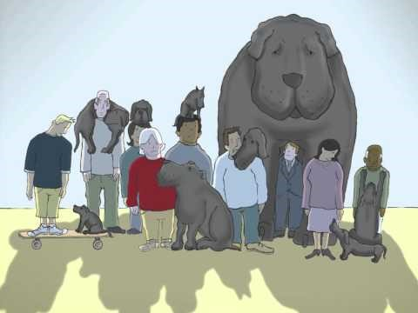

Slide 9
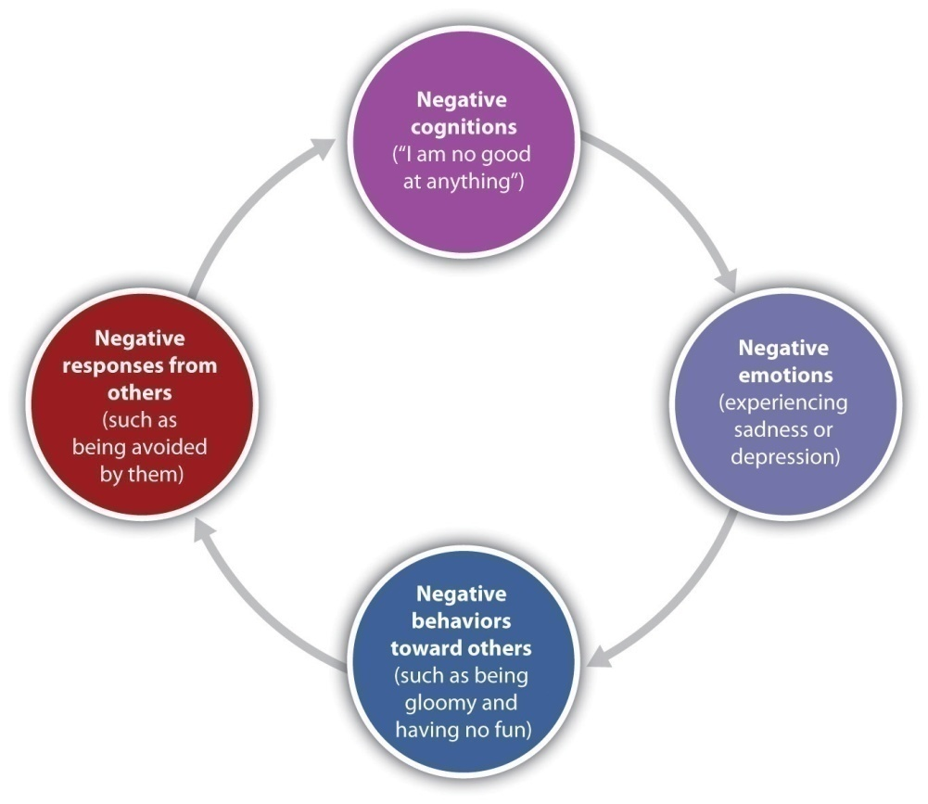
Negative thinking
‘Default mode’ of the brain - research shows that when
the brain has nothing specific to do it tends to revert to
looking for problems to solve and seeking out difficulties.
Ruminative thinking.
Automatic negative thoughts.
Gathering evidence to support a negative view.
Preoccupation with the past;
Self criticism.
Getting depressed about feeling depressed.
“Yes, but” responses.
Notes:
So let’s start with the negative thinking- the ‘cognitive’ aspects of low mood. Here are some of the ways in which it can get entrenched. Research shows that when the brain has nothing specific to do it tends to revert to looking for problems to solve and seeking out difficulties……e.g. Did I talk to my friend right? Does she still like me? Etc Tends to increase self- critical thinking and comparison of self with others. So learning to ground and be in the present is a good way out
Think again about how these negative thoughts can also ‘tighten’ the spiral of low mood.

Slide 10
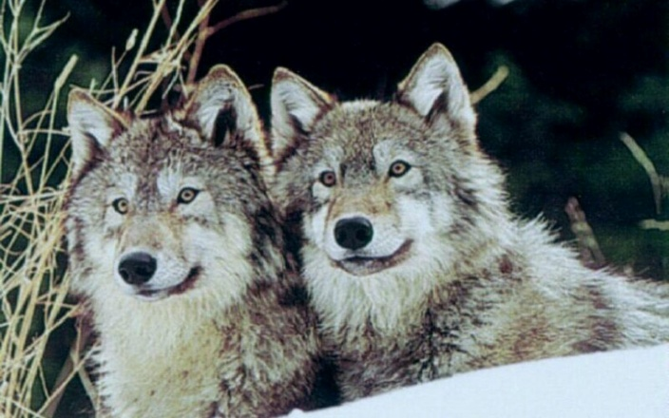
Feeding the Wolf!
An old Cherokee chief was teaching his grandson about life...
"A fight is going on inside me," he said to the boy.
"It is a terrible fight and it is between two wolves.
"One is evil - he is anger, envy, sorrow, regret, greed, arrogance, self-pity, guilt, resentment, inferiority, lies, false pride, superiority, self-doubt, and ego.
"The other is good - he is joy, peace, love, hope, serenity, humility, kindness, benevolence, empathy, generosity, truth, compassion, and faith.
"This same fight is going on inside you - and inside every other person, too."
The grandson thought about it for a minute and then asked his grandfather,
"Which wolf will win?"
The old chief simply replied,
"The one you feed.“
Author unknown.

Slide 11
Breaking into the Spiral
Acceptance and self compassion
Behavioural activation
Challenging negative thinking
Developing support systems
Having a routine
Developing an ‘observing self’
Small steps
Notes:
So how do we feed the ‘right wolf’ and start spiralling upwards not downwards?
The good news is that you can start any where- tackle any of the 5 key areas- to make a difference. Which ever you choose first is up to you. Which are you most likely to choose first? Here are some ideas

Slide 12
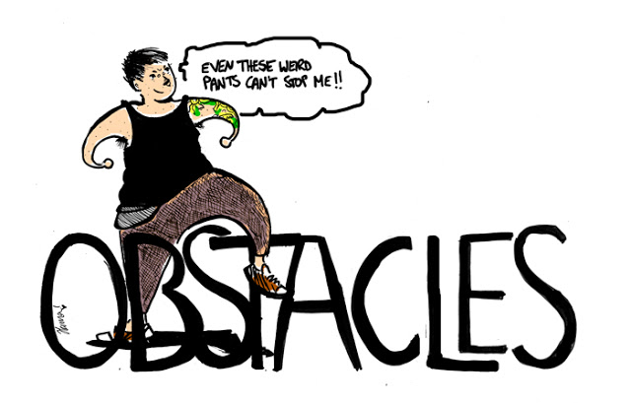

Upward spiral/ action plan/ 1st steps/obstacles
Notes:
Let’s try to make a start on a plan that would work for you.
Remember- one step at a time- sometimes just making 5% difference is all you are looking for.
Recovering from low mood can be like climbing Snowdon via the Llanberis path- very long, rather monotonous, it doesn’t feel like you are getting anywhere. It’s not until you look round that you begin to see the difference…
There will be obstacles- but also ways around them

Slide 13

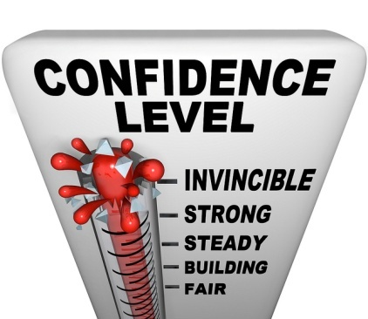
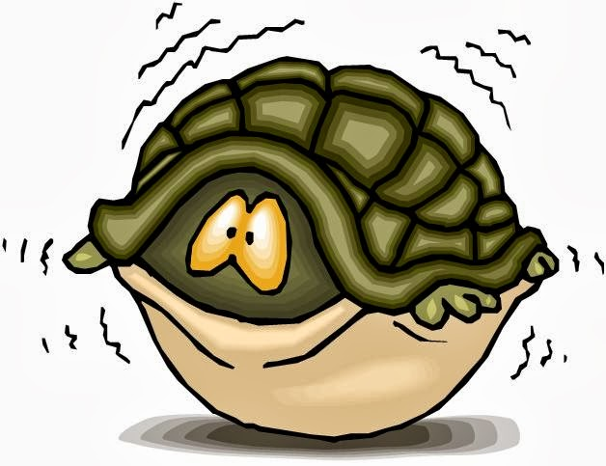

Activation comes before motivation:
‘Fake it till you make it’
‘Feel the fear and do it anyway’
‘Keep calm and carry on’
Notes:
First of all activation. A lot of work has been done in recent years on getting people to challenge and change behaviours as a first step in recovering from low mood. Research has indicate that even doing something quite small, in terms of physical activation- such as walking upstairs! can help list someone's mood
Make a list of things you can do that have a ’cardio vascular’ element to them (ie, getting out of breath). Have a list of things that include something ‘immediate’ as well as things that might need a bit of planning. Can you do some of these with a friend?
REMEMBER YOU ARE NOT GOING TO FEEL LIKE DOING THESE THINGS TO START WITH!
It may feel pointless, you might feel too tired or you may feel anxious.
Think about things that you can do that could give you pleasure, a sense of achievement or contact with others.
Look at the Activity Wheel handout- read through-

Slide 14
ho
Challenging negative thoughts- Thought Record sheet.
Notes:
Look back to Slide 8. Let’s try to find a way of being able to notice, and challenge the negative thinking that keeps us feeling low.
Thought record sheet- and explain

Slide 15



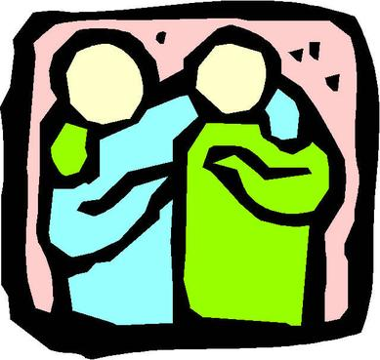

What might work for you?
Set realistic goals.
Plan ahead.
Involve someone else.
Acknowledge that small simple tasks are valuable.
Regular doses are most helpful.
What gives you pleasure/achievement/ closeness?
Notes:
So what might work for you?- everyone is different.
SMART goals
Think again about the 5 key areas, and consider what you could do that might help alleviate for example physical aches and pains, sleep problems. What behavioural steps could you take to make sure you are not avoiding, hiding away?
What gives you pleasure/achievement/ closeness?

Slide 16
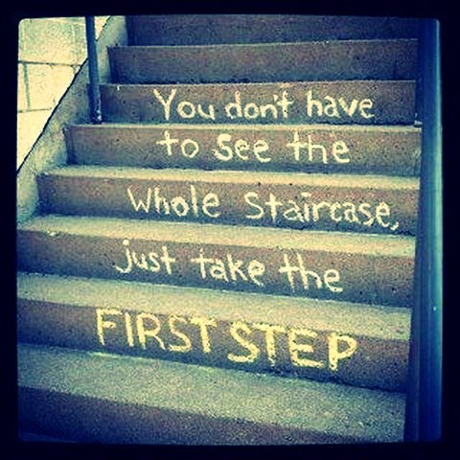

Write down your three first steps.
1…………………
2…………………
3………………...
Notes:
Make a note of where you are going to start, after you leave this workshop today.
Any questions?

Slide 17
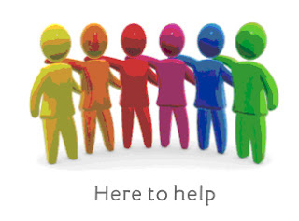
Resources available:
Use support systems available within the University.
Academic support - personal tutors, subject tutors, Dyslexia Service, Study Support Service
Student Support - Disability Services, Money Support
Student Union Services
Learn more about low mood and ways to overcome it.
Attend Building Resilience workshops - see Counselling Service website
Learn Mindfulness Meditation. https://www.bangor.ac.uk/mindfulness/audio/index.php.en
Look at self–help links on Counselling Service website
Look at online resources.
This Workshop attracts BEA points.
Notes:
Here’s a list of resources available to you.
How many might you consider using?
Remember- be kind to yourself, and give your strategies some time to work.
If you came here as a first step, see how you get on with these ideas. If you came here because you are worried about someone else, feel free to pass the handout on. If you still feel that you need further help, then contact us again

